Slide 1
Design Patterns
By Mareck Kortylevitch and Piotreck Ratchinsky

Slide 2
What is Design Pattern?
Recurring solution to known problems
Workaround to problems that arise when developing software within a particular context

Slide 3
History
Precursor of design pattern was Christopher Alexander
First Design Patterns used in architecture

Slide 4
Why to use DP?
Help you learn from others' successes instead of your own failures
Provide a communication platform concerning elegant, reusable solutions to commonly encountered programming challenges

Slide 5
Why to use...continuation
Enforce using techspeak
Isolate changes in the code
Design and interaction of objects

Slide 6
Design Patterns Examples
Facade
Adapter
Singleton
Abstract Factory
Bridge

Slide 7
Facade - definition
Provide a unified interface to a set of interfaces in a subsystem. Façade defines a higher-level interface that makes the subsystem easier to use.

Slide 8
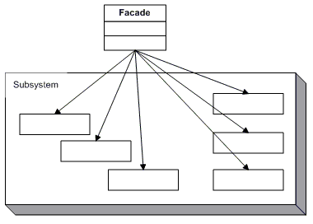
Facade - UML class diagram

Slide 9
Facade - example
Facade (MortgageApplication)
  knows which subsystem classes are responsible for a request.
  delegates client requests to appropriate subsystem objects.
Subsystem classes (Bank, Credit, Loan)
  implement subsystem functionality.
  handle work assigned by the Facade object.
  have no knowledge of the facade and keep no reference to it.

Slide 10
Facade – example diagram
Facade
Subsystems
Bank
Credit
Loan

Slide 11
Singleton - definition
ensure a class has only one instance and provide a global point of access to it.
defines an Instance operation that lets clients access its unique instance. Instance() is a class operation.
responsible for creating and maintaining its own unique instance.

Slide 12
Singleton – UML
Singleton
-static Singleton: instance
-Singleton()
+static getInstance():Singleton

